Slide 1
Country Landscape: Indonesia
Prepared by
Riznawaty Imma Aryanty

Slide 2
Outline
Purpose of the exercise
Tool (Matrix on Country Landscape)
Approaches to answer the questions
Responds from the matrix:
I. Family planning plan
II. Situation of plan implementation
III. Family Planning committee
IV. Partners in family planning
V. Key indicators
Comments on the tool

Slide 3
Purpose of the Exercise
Help gain a better understanding of the current family planning (FP) situation in all commitment countries.
As reference information for the FP2020 Country Engagement Working Group and the FP2020 Reference Group.

Slide 4
Tool (Matrix on Country Landscape)
Consists of questions on:
Government institution, contact person & address
FP Plan: status, elements
Situation of Plan Implementation
FP Committee
Partners in FP
Key indicators
Types of answers
open-ended.
drop-down menu.

Slide 5
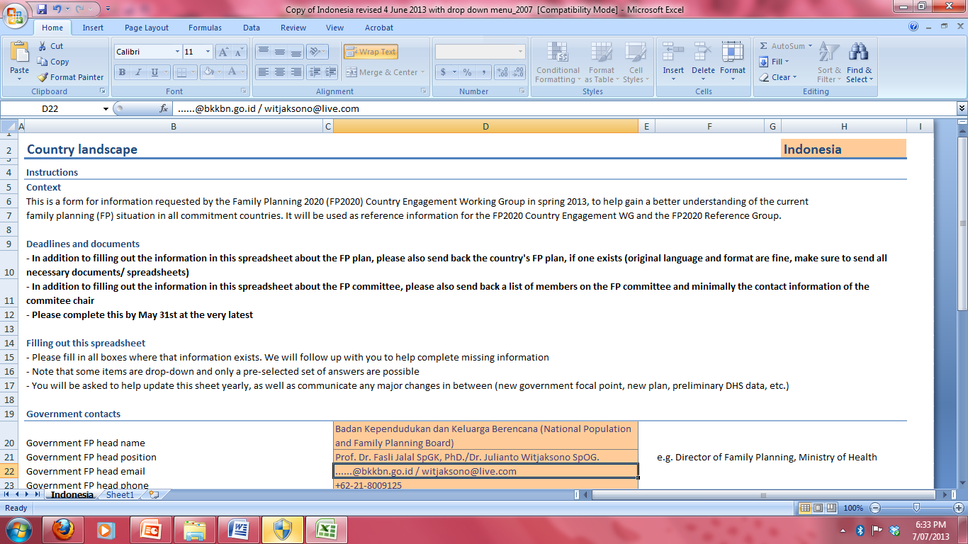
the Matrix....

Slide 6
Additional information....
No | Point of Discussion | Answer | Supporting Information and References
1 | Plan Status
a | - Existence or progress in development | FP plan exists, of medium quality | The main family planning plan refers to the national medium-term development plan 2010 to 2014. This plan specifies detail of activities focusing on ensuring equality and self-reliance on family planning through 23,500 public and private clinics throughout Indonesia. The targets stated in the plans refer to the achievement of millennium development goals number 5b. Source: Medium term development plan 2010-2014 in health sector
b | - Detail of plan | Plan developed at national level (Strategic Plan for Population and Family Planning Development 2010-2014) | The plan is further described in the strategic plan for population and family planning development 2010-2014. This document serves as a guideline for development of annual plan. In this strategic plan road maps for achieving the targets are stated together with recommended activities. Source: Rencana Strategis Pembangunan Kependudukan dan Keluarga Berencana tahun 2010-2014 (BKKBN 2011)
c | - Costing | Activities described, with costing for broad areas | The plan is detailed annually in a three-party agreement involving National Population and Family Planning Board, National Planning Board and Ministry of Finance. Indicative budget ceilings for family planning are decided in this meeting. Source: Dokumen Kesepakatan Trilateral meeting pembahasan pagu indikatif BKKBN (2013)

Slide 7
Approaches to answer the questions
Discussion with resources persons.
Document Reviews.
Feedbacks of the completed matrix

Slide 8
I. Family Planning Plan(1)
Existence of progress in development: FP plan exists, of medium quality
Detail of plan: Plan developed at national level
Costing: Activities described, with costing for broad areas
Financing: Plan mostly funded, with a focus on covering all critical activities (particularly at the central level)
Implementation: Plan having significant issues of implementation
Relation to other plans: Stand alone FP plan
Plan name: Strategic plan for Population and Family Planning Development (2010-2014), Population and Family Planning Kencana (2013 to 2016).

Slide 9
I. Family Planning Plan(2)
Date of plan creation/last review: launched 2010
Years spanned by plan: 2010-2014
MCPR goal set in plan: 65%
Other goal set in plan:
TFR = 2.1
NRR = 1
Median of age of marriage to 21 years
ASFR 15-19 years to 30 per 1000 women
Unmet needs to 5%
Reduce unwanted pregnancy from 19.7 to 15%
Reduce disparity of TFR, unmet needs and CPR
Establishment of District Population and FP Agency in 435 districts
Stakeholders involved in plan creation: BKKBN, BAPPENAS, Ministry of Finance.
Notes:
Strategic Plan for Population and Family Planning Development was developed in 2009 and launched in 2010
Population and Family Planning Kencana KKB Kencana program was developed and launched in 2012

Slide 10
I. Family Planning Plan(3)
Plan element
Demand creation: comprehensive FP information; FP behavior change; Age-appropriate comprehensive sexuality education: Plan includes these interventions.
Plans for coordination of demand creation activities at national, regional and local levels: not clearly stated.
Service delivery/access: use of market segmentation, Infrastructure development to enable physical access, broader access to long-acting reversible methods, assurance quality of care, procurement and supply chain: Plan contains several activities.

Slide 11
I. Family Planning Plan(4)
Procurement and supply chain: Forecasting process taking into account current stocks and rate of use of all methods, although there are issues related to the logistic arrangement
Policy and Advocacy: available in the plan.
Performance management and accountability: Plans contain limited activities in performance management and accountability
Ability to track relevant metrics from the health centre level, regional and national level: Ability to track relevant metrics from the health centre level, regional and national level.
Key gap/needs in developing rigorous plan: FP plan at the central level is quite comprehensive, however, FP is often not the priorities in districts plan.

Slide 12
II. Situation of Plan Implementation(1)
Limitation to plan implementation.
Policies limiting access to contraceptives: Unmarried people are not included in as targets of FP programme.
Existence of gender policies and existence of policies on women’s health & SRHR: limited policy exist
If essential medicine list exist, are contraceptives listed as part of the list? essential medicines list exists, and many contraceptives are included, including long-acting methods

Slide 13
II. Situation of Plan Implementation(2)
Method choice and availability:
Pills, injectables, condoms: offered in all facilities
Implants, IUD: offered in most facilities, or in all facilities with qualified staff (due to regulations)
Female sterilization: only offered in limited facilities
Access FP services in health centres (at least one method): FP theoretically available in all health facilities
Choice of FP services in health centres (at least five methods): some facilities offer at least 5 choices

Slide 14
II. Situation of Plan Implementation(3)
Restriction of product and manufacturer quality qualification: Registration of products are required before it can be nationally distributed.
Depth of procurement forecasting process: medium complexity based on current stock.
Use of AccessRH for procurement: not used.
Use of Pledge Guarantee for Health procurement: not used.

Slide 15
III. Family Planning Committee(1)
Committee status: FP Committee in place. There are several national committee/working groups/task forces existed.
Committee names: task force population and family planning Kencana, task force for contraceptives logistic availability.
Frequency of meetings: once or twice a year
Relation to other committees: standalone committee for family program only.
Source of FP committee resources: covered by Government regular fund.

Slide 16
III. Family Planning Committee(2)
Scope of meeting (issues discussed/typical agenda) - FP plan implementation, FP plan monitoring, contraceptive procurement and security: occasionally covered, as needed
Committee membership: BKKBN, Ministry of Health, related sectors.

Slide 17
III. Family Planning Committee(3)
Is there separate committee for contraceptive procurement?
Committee status: Separate contraceptive procurement committee in place, of medium quality
Committee name: Task force on contraception availability on Family Planning and Reproductive Health.
Frequency of meetings: as required.

Slide 18
IV. Partners in Family Planning(1)
Partner coordination unit, if one exists: partnership coordination unit in place.
Status: recently established (May 2013).
Committee name: Country Engagement Working Group (ECWG).
Topics covered - FP, RH, general health: FP2020 (first meeting).
Coordinated by: National Population and Family Planning Board/BKKBN.
Frequency of meetings: Monthly.

Slide 19
IV. Partners in Family Planning(2)
Donors present in country
Direct FP program funding: UNFPA
Civil society present in FP in country: faith-based foundations with the networks, local and women NGOs.
NGO present in FP in country: JHU/CCP, PKBI/IPPF, Mc Kinsey, JHPIEGO.
Implementing partners present in FP in country: PKBI/IPPF, JNPK, PKMI .
Private sectors present in FP in country: pharmaceutical companies, private hospitals, midwives, medical schools.
Key gaps/needs in partner support: the need to have better coordination.

Slide 20
V. Key Indicators(1)
DHS CPR: 61.4% (IDHS 2007).
DHS MCPR: 57.4% (IDHS 2007).
DHS unmet need: 13.1% (IDHS 2007).
Most recent CPR: 61.9% (IDHS 2012).
Most recent MCPR estimate: 57.9% (IDHS 2012).
Most recent unmet need: 11.4% (IDHS 2012).
Contraceptive commodity stockout:
Stockout occurring at central level in last 12 months: no stockout at central level in the past 12 months.
Stockout occurring at point of delivery in last 12 months: stockout of a least one contraceptive method is reported at the service delivery points.

Slide 21
V. Key Indicators(2)
Year of budget data: 2013.
Budget line for FP services: Rp. 2.6 Trillion (US$273 million).
Budget line for contraceptive procurement: Rp. 540 Billion (US$ 55 Million).
Strength of financial commitment from government: significant support of costs of FP services and contraceptives (particularly at the central level).
Change in government financial commitment to FP over time: increasing funds for family planning at the central level within the recent years.

Slide 22
Comments on the Tools
Some questions are too broad, while the answers are too limited and require answers selection from a drop-down menu. Only pre-selected answers are possible which may not be suitable to describe country situation.
Some cells of the matrix can not be filled indicating that the tool is not really ready for distribution.

Slide 23
Thank You immabatubara@gmail.com

